Slide 1
Level 4/5 Group 5
Joseph Barber, Bethany Cowle,
Courtney-Jade Pearson, Henry Smith

Slide 2

Emotion 1: Onism
The frustration of being stuck in just one body that inhabits only one place at a time.
Why?
Many different paths and options.
Applies to the mechanics and gameplay.
HS

Slide 3
Emotion 2: Monachopsis
The subtle but persistent feeling of being out of place
Created through the narrative
Characters past and purpose is unknown
BC

Slide 4
Narrative
Build narrative as you play.
Collecting memories.
Character feels emotions along with the player.
Monachopsis in narrative
HS

Slide 5
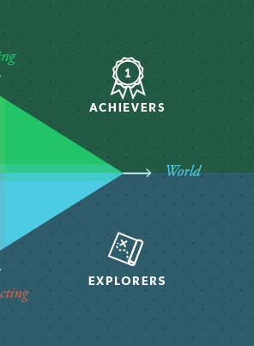
Target Demographic
Bartle’s taxonomy of Player Types: Achievers and Explorers
Age: 16 – 30
Gender: Males and females
CP

Slide 6
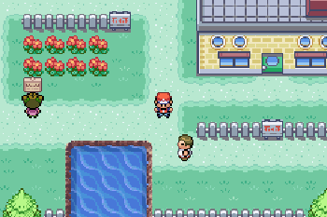
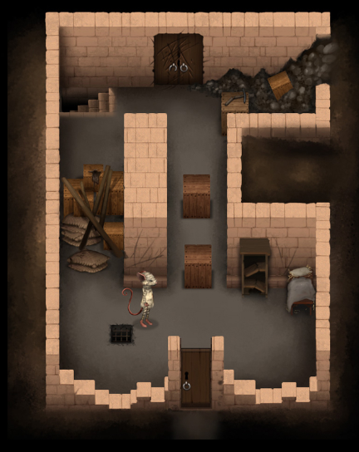
Genre/Style
Puzzle
Strategy
Angled top-down perspective
BC

Slide 7
Unique Selling Point
Unravel narrative through gameplay
Take control of NPCs in the game world
Access different mechanics upon taking over an NPC
JB

Slide 8
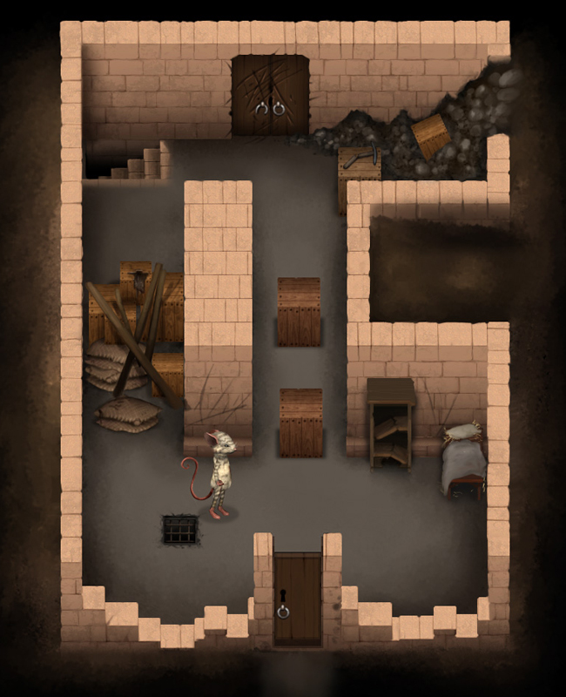

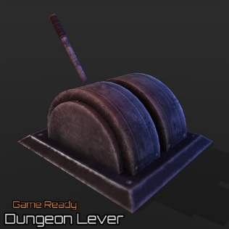
Mechanics: What does the player do?
Walk
Take control of NPCs
Operate objects Key/locks Switches/levers/ buttons etc.
This will cost one “Charge”
JB

Slide 9
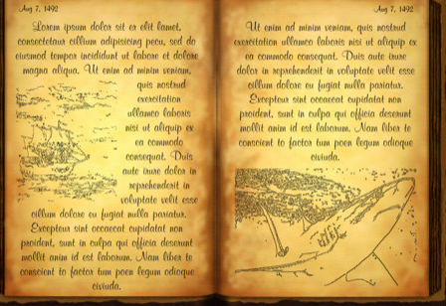
Player Rewards
Collect diary memories Over time, piece together narrative.
Collecting additional “Charges”
CP

Slide 10
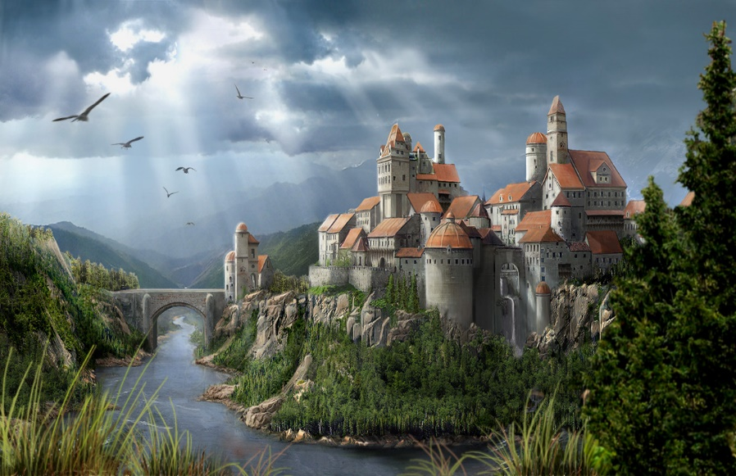

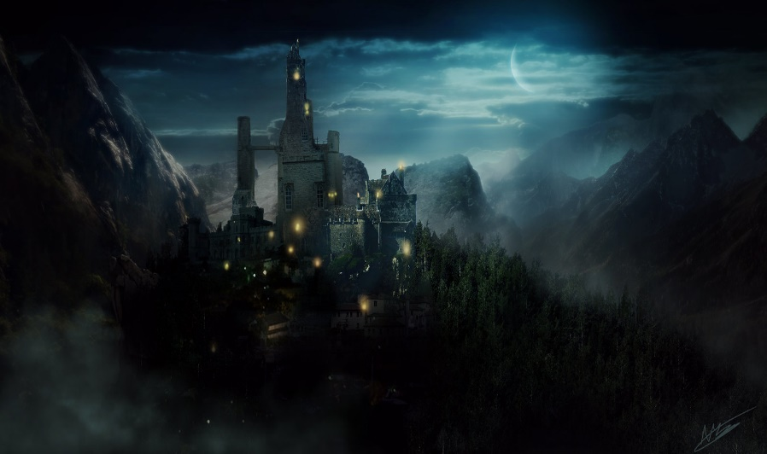
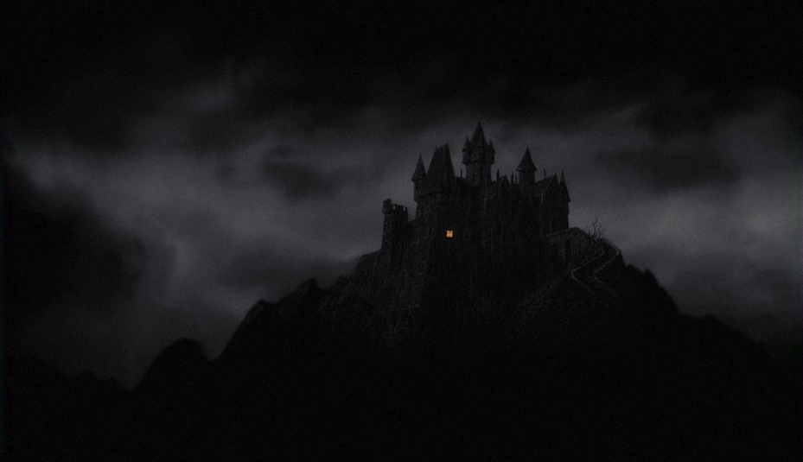
Mood boards
HS

Slide 11
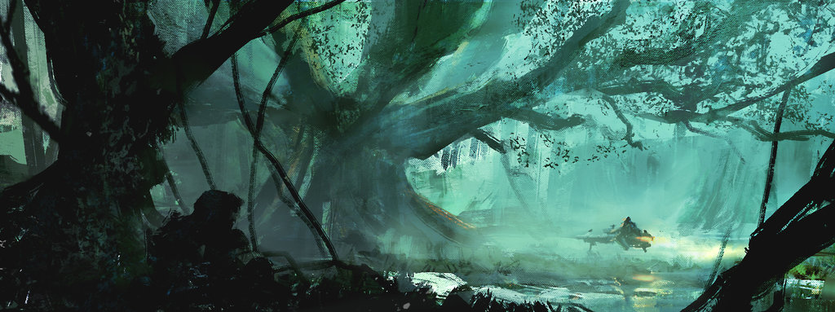
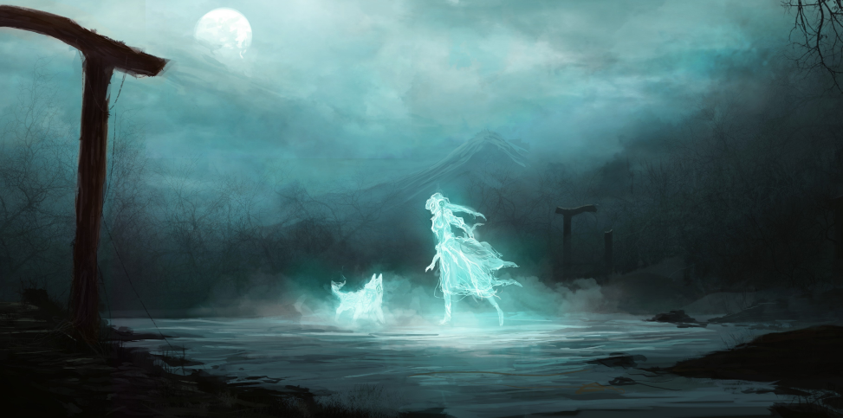
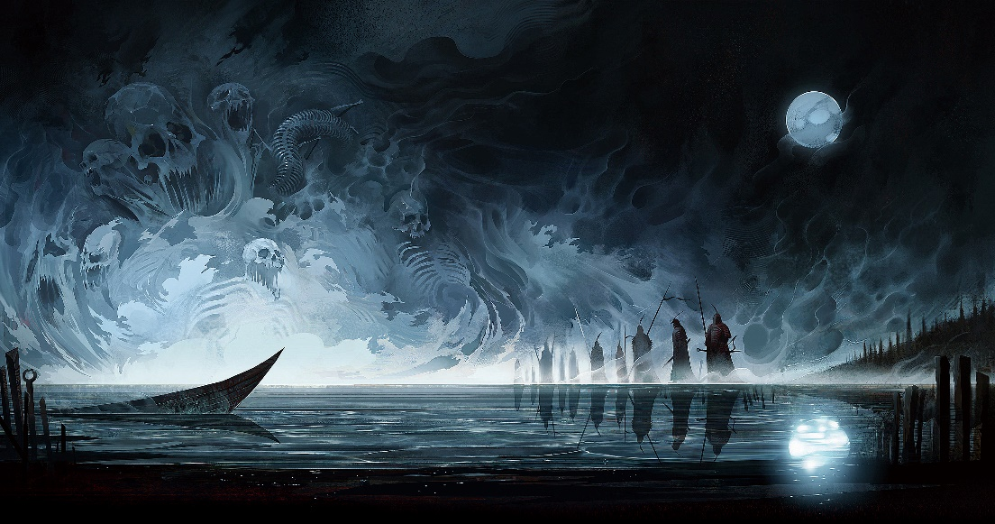
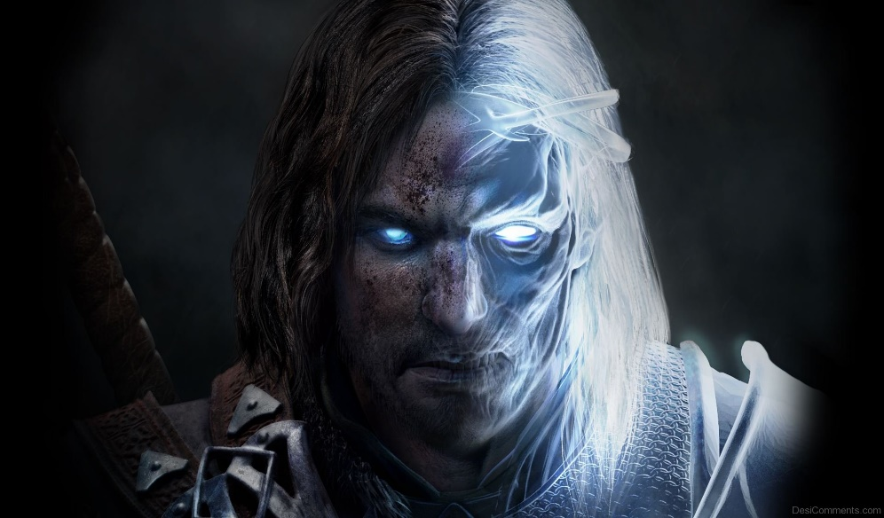
Mood boards
HS

Slide 12
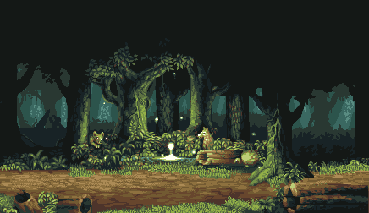
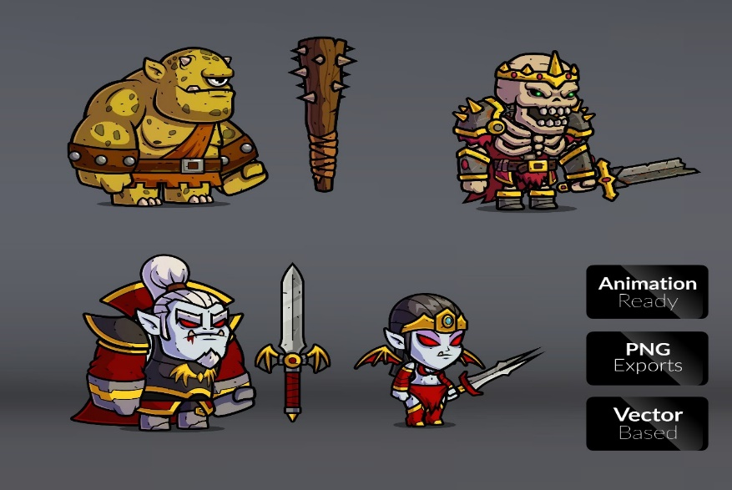
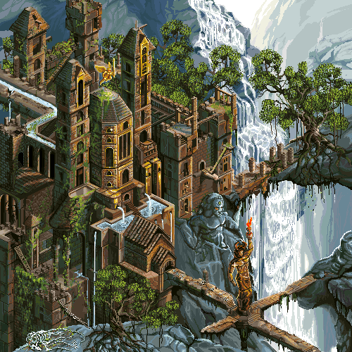
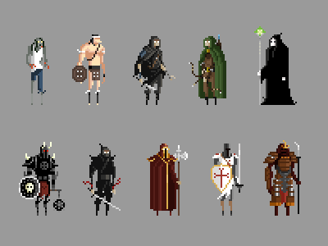
Art style
HS

Slide 13
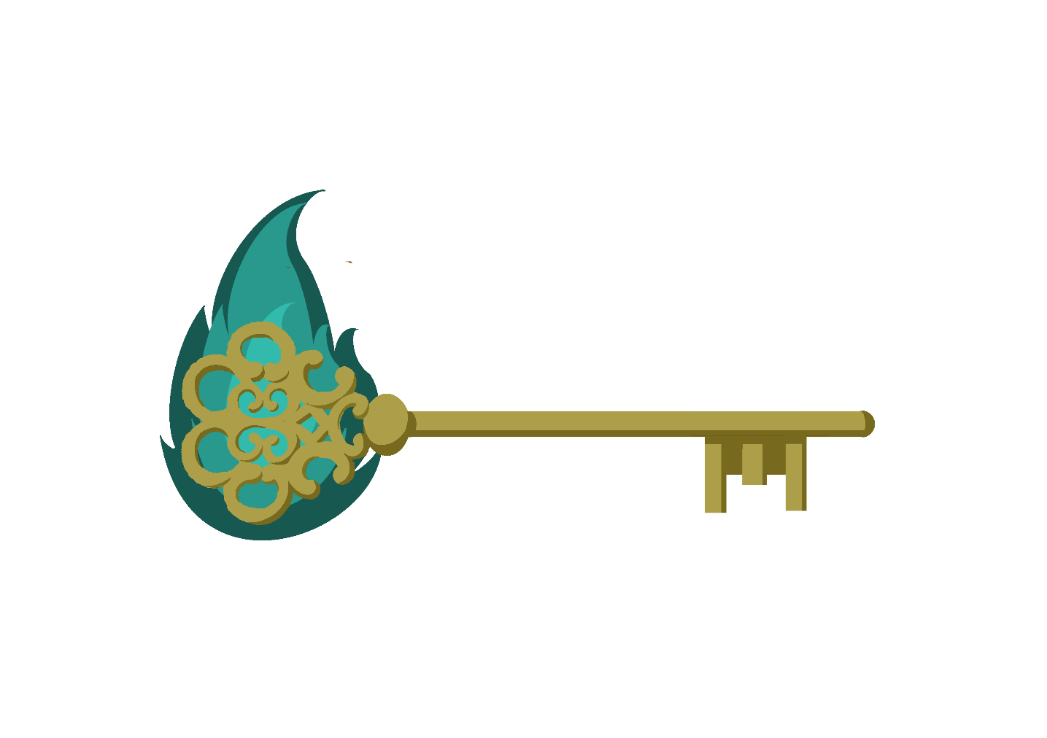
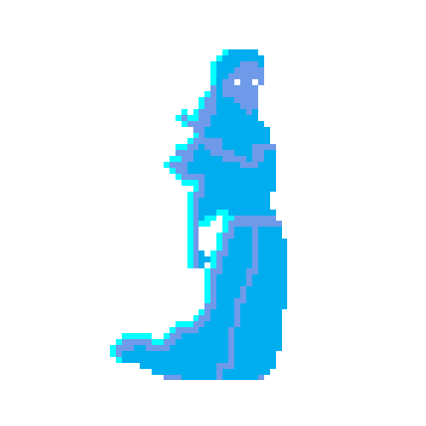



Art assets
BC

Slide 14
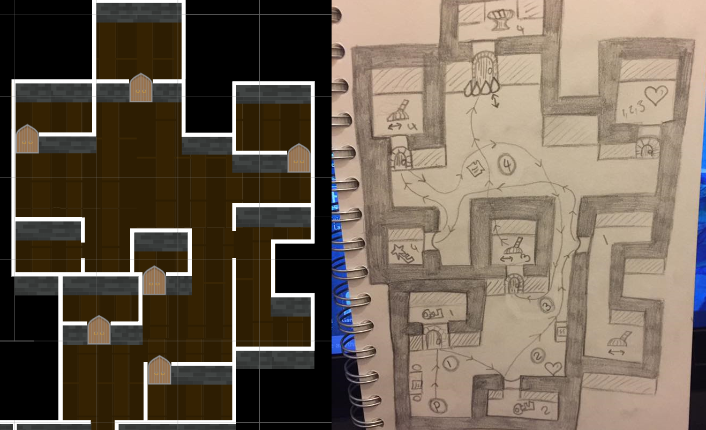
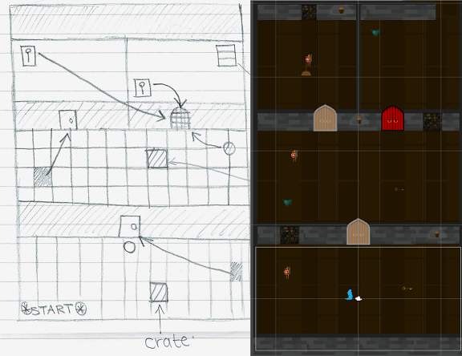
Level Design development
CP

Slide 15
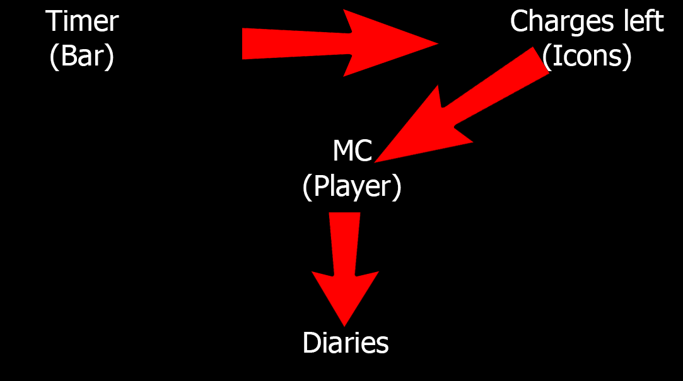
Visual Hierarchy
JB

Slide 16
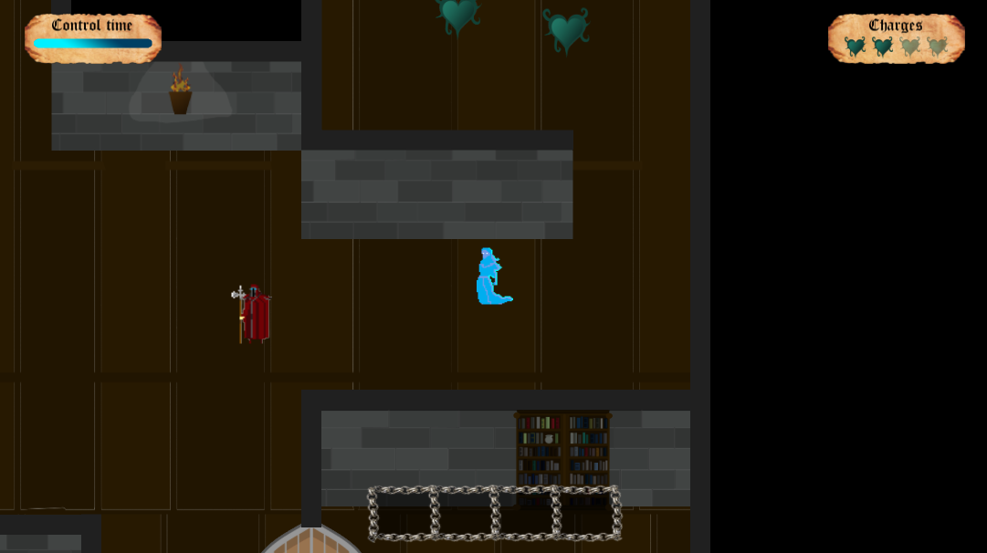
Gameplay screenshot
CP

Slide 17
Gameplay
Gameplay

Slide 18
Play-testing feedback
Hints for Guards/Keys/Doors.
Audible feedback:
Doors,
Charges,
Etc.
Controls:
Consistent action button
Hint the controls to the player
JB

Slide 19
Play-testing feedback
Levels became too complex too quick
Add more charges.
Guards can open any lever
CP

Slide 20
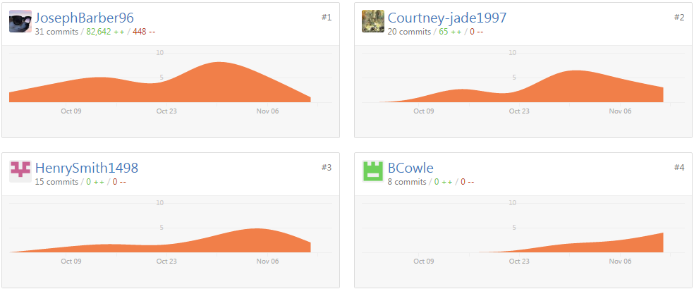
Management
Email count since last presentation:
BC: 8
JB: 16
CP: 15
HS: 10

Slide 21
Bibliography
Packard E. 2007. That teenage feeling. [Online]. April 2007. Available online: http://www.apa.org/monitor/apr07/teenage.aspx [Date of access: Thursday 13th October 2016].

Slide 22
Questions.
?

